Slide 1
World Wid Web
Chapter one

Slide 2
Objectives
Know various ways that businesses are using the Internet.
Describe how the Internet is evolving
To understand protocols.
Describe the purpose of ISP and the services that it offers
Describe the hierarchical structure of the Internet
Know the client–server architecture

Slide 3
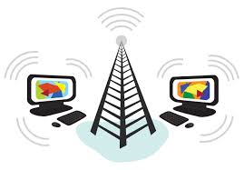
Internet and Its Uses
It is an international network of networks that links together billions of computers.
It is commonly referred to as the 'Net’.
It helps individuals and businesses sectors to share information, resources, and services.
Internet used for:-
E-Commerce
Direct Communicate to the world
Research against the competitor
Training: interactive medium and long distance learning etc.

Slide 4
Protocol
A protocol is a set of rules or conventions that govern how data is transmitted and received between devices or systems.
There are numerous protocols- the set of rules that govern how devices communicate on networks.
Examples:
Hypertext Transfer Protocol(HTTP)
Long Range Wide Area Network (LoRaWAN)
Bluetooth.
File transfer protocol (FTP)
Message Queue Telemetry Transport (MQTT)
Constrained Application Protocol (CoAP)
Advanced Message Queuing Protocol (AMQP)
Notes:
MQTT (MQ Telemetry Transport) is a lightweight open messaging protocol that provides resource-constrained network clients with a simple way to distribute telemetry information in low-bandwidth environments.
Constrained Application Protocol (CoAP) is a specialized web transfer protocol for use with constrained nodes and constrained networks in the Internet of Things. CoAP is designed to enable simple, constrained devices to join the IoT even through constrained networks with low bandwidth and low availability.
The Advanced Message Queuing Protocol (AMQP) is an open standard for passing business messages between applications or organizations. It connects systems, feeds business processes with the information they need and reliably transmits onward the instructions that achieve their goals.

Slide 5
Delivering Internet services to end-users
Internet service provider (ISP) is an organization that provides a myriad of services.
ISP can be organized in various forms, such as commercial, community-owned, non-profit etc.
ISPs provided Internet access, domain name registration, web hosting etc. .
To gain Internet access, it is first necessary to have a connection to ISP
ISPs offer various connection options.
Dialup access
Dialup access is an inexpensive option that uses any phone line and a modem.

Slide 6
Delivering Internet services to end-users
Digital subscriber line (DSL)
DSL is more expensive than dialup, but provides a faster connection.
DSL also uses telephone lines, but unlike dialup access, DSL provides a continuous connection to the Internet.
Needs a special high speed modem to connect the host or LAN

Slide 7
Delivering Internet services to end-users
Cable Modem
A cable modem is a connection option offered by ISP
The Internet signal is carried on the same coaxial cable that delivers cable television to homes and businesses.
Satellite
Satellite connection is an option offered by satellite service providers.
The user's computer connects through Ethernet to a satellite modem that transmits radio signals to the nearest point of presence (POP) within the satellite network.
Notes:
A cable modem is a networking device that enables high-speed internet access through a cable television network infrastructure. It serves as a bridge between your local network (your home or business) and the internet service provider's (ISP) network. Cable modems receive data signals from the ISP via coaxial cables and then translate these signals into data that can be used by your computer or other devices to access the internet.

Slide 8
Internet Hierarchy
The Internet has a hierarchical structure.
At the top of this hierarchy are the ISP organizations.
The ISP point of presence (POPs) connect to an Internet Exchange Point (IXP) also called a Network Access Point (NAP).
A point of presence was a location where a long-distance carrier could terminate services and provide connections into a local telephone network.
An IXP or NAP is where multiple ISPs join together to gain access to each other's networks and exchange information.
Internet backbone is like an information super highway that provides high-speed data links to interconnect the POPs and IXPs in major metropolitan areas around the world.
Notes:
The internet backbone is made up of the fastest routers, which can deliver 100Gbps trunk speeds.
These routers are made by vendors including Cisco, Extreme, Huawei, Juniper, and Nokia, and use the border gateway protocol (BGP) to route traffic among themselves.

Slide 9
Internet Hierarchy
The primary medium that connects the Internet backbone is fiber-optic cable.
ISPs are classified into different tiers according to how they access the Internet backbone:
Tier 1 ISPs
are the top of the hierarchy.
Tier 1 ISPs are huge organizations that connect directly with each other to create the global Internet backbone.
Has its own routers

Slide 10
Internet Hierarchy
Tier 2 ISPs
are the next tier in terms of backbone access.
Tier 2 ISPs can also be very large, even extending across several countries.
To provide their customers with global Internet access, some Tier 2 ISPs pay Tier 1 ISPs to carry their traffic to other parts of the world.
Tier 3 ISPs
the farthest away from the backbone.
found in major cities and provide customers local access to the Internet.
Tier 3 ISPs pay Tier 1 and 2 ISPs for access to the global Internet and Internet services.

Slide 11
History of Internet
Internet expansion
Month # of Web sites 1/1993 5 12/1993 623 6/1995 23,500 1/1996 100,000 1/1997 646,160 8/1997 1,269,800 Today the number of sites would be almost untraceable.
Notes:
January 1993: 5 websites.
December 1993: 623 websites.
June 1995: 23,500 websites.
January 1996: 100,000 websites.
January 1997: 646,160 websites.
August 1997: 1,269,800 websites.
This data illustrates the exponential growth of the internet during the mid-1990s and into the late 1990s, particularly with the advent of the World Wide Web and increasing accessibility to internet services. The number of websites increased dramatically over just a few years, reflecting the rapid expansion of online content and services during that period.

Slide 12
Terms
Web server
It is a piece of computer software that can respond to a browser's request for a page, and deliver the page to the Web browser through the Internet
Hypertext
Machine-readable text
It is not sequential but is organized
Internet Service Provider (ISP)
A company that provides Internet service
Notes:
Hypertext refers to text displayed on a computer or other electronic device that contains hyperlinks, allowing users to navigate easily between different pieces of information. The concept of hypertext originated from the pioneering work of Ted Nelson and others in the 1960s and 1970s, and it became widely popularized with the development of the World Wide Web in the late 20th century.

Slide 13
Terms
Uniform Resource Locator (URL)
It is an address on the Internet, such as http://www.wku.edu.et, which enables computers and other devices to visit it.
Web Address: the address of information and/or resources available on the internet.
http: http stands for hypertext transfer protocol.
ftp: ftp stands for File Transfer Protocol. It is used to upload or download various files.

Slide 14
Overview of Internet
How does it work?
A server machine running a web server
Browser connects and requests a page
A machine running a browser
Server sends back the requested page

Slide 15
Overview of Internet
How does it work?
Requesting the page http://www.yahoo.com
The browser broke the URL into 3 parts:
The protocol ("http")
The server name ("www.yahoo.com")
The file name ("index.html")
Browser ➔ DNS ……Name to IP translations
Browser➔ Server …..Creation of connection

Slide 16
Overview of Internet
Browser sends a GET request to the server, asking for the file "http:// www.yahoo.com/index.html".
The server then sends the HTML text for the Web page to the browser
Browser displays the page based on the HTML tag

Slide 17
Overview of Internet
Top Level Domain (TLD) names
.com - Originally for commercial organizations, but now used by individuals, government agencies, and non_profits as well
www.google.com
.Net - Internet service providers and other network-related companies
www.ethio.net
.org - Noncommercial (often nonprofit) organizations
www.sourceforge.org
.gov - government agencies
www.ena.gov.et
.mil - military
.edu - Educational domains
www.wku.edu.et
.int - International organizations like NATO and the International Red Cross

Slide 18
Overview of Internet
More three-or-more-letter TLDs are coming into use, such as these:
.aero - Airlines
.coop - Cooperatives
.info - Anyone
.name – Individuals
Notes:
Goddady--

Slide 19
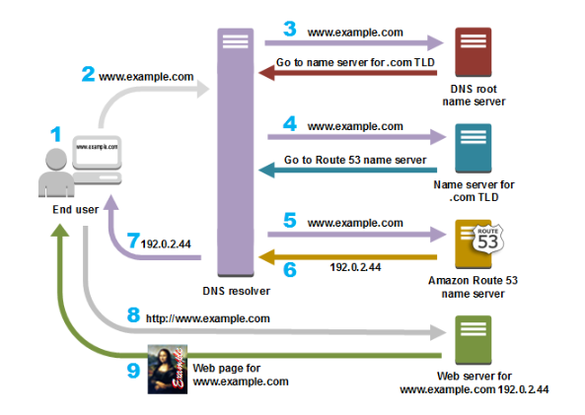
Overview of Internet
Internet Address
Each computer connected to the Internet must have a unique address, known as IP address.
Internet addresses are in the form #.#.#.# where # must be a number from 0 – 255
How Does DNS Route Traffic To Your Web Application?

Slide 20
Overview of Internet
A user opens a web browser, enters www.example.com in the address bar, and presses Enter.
The request for www.example.com is routed to a DNS resolver, which is typically managed by the user's Internet service provider (ISP).
The DNS resolver for the ISP forwards the request for www.example.com to a DNS root name server.
The DNS resolver for the ISP forwards the request for www.example.com again, this time to one of the TLD name servers for .com domains. The name server for .com domains responds to the request with the names of the four Amazon Route 53 name servers that are associated with the example.com domain.
The DNS resolver for the ISP chooses an Amazon Route 53 name server and forwards the request for www.example.com to that name server.
The Amazon Route 53 name server looks in the example.com hosted zone for the www.example.com record, gets the associated value, such as the IP address for a web server, 192.0.2.44, and returns the IP address to the DNS resolver.
The DNS resolver for the ISP finally has the IP address that the user needs. The resolver returns that value to the web browser. The DNS resolver also caches (stores) the IP address for example.com for an amount of time that you specify so that it can respond more quickly the next time someone browses to example.com. For more information, see time to live (TTL).
The web browser sends a request for www.example.com to the IP address that it got from the DNS resolver. This is where your content is, for example, a web server running on an Amazon EC2 instance or an Amazon S3 bucket that's configured as a website endpoint.
The web server or other resource at 192.0.2.44 returns the web page for www.example.com to the web browser, and the web browser displays the page.

Slide 21
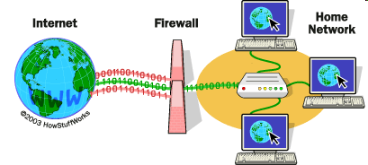
Overview of Internet
Firewall –
It used to filters the information coming through the Internet connection into your private network or computer system.
If an incoming packet of information is flagged by the filters, it is not allowed to pass through
Notes:
A firewall is a security tool that monitors incoming and/or outgoing network traffic to detect and block malicious data packets based on predefined rules, allowing only legitimate traffic to enter your private network. Implemented as hardware, software or both, firewalls are typically your first line of defense against malware, viruses and attackers trying to make it to your organization’s internal network and systems.

Slide 22
Overview of Internet
Methods/Types of Firewalls
Packet filtering:-
controls the network access by analyzing the outgoing and incoming packets.
It lets a packet pass or block its way by comparing with pre-established criteria like allowed IP addresses, packet type, port number, etc.
Proxy service:-
Also called the application level gateways,
It is the most secured type of firewalls
protect the network resources by filtering messages at the application layer.
Stateful inspection:-
is a firewall technology that monitors the state of active connections and uses this information to determine which network packets to allow through the firewall.

Slide 23
World Wide Web
The World Wide Web is a system of interlinked hypertext documents (websites) you can accessed through the Internet
Website consist of multiple web pages interconnected through hyperlinks.
These pages can contain text, images, videos, interactive elements, and other multimedia content.
Websites may also incorporate features like forms, search functionality, user authentication, and e-commerce capabilities, depending on their specific goals and requirements.
Architecture
The WWW is a distributed client-server service,
client using a browser can access a service using a server.
The service provided is distributed over many locations called sites.
Notes:
The World Wide Web (WWW) relies on a client-server model with some key components working together to deliver information to your screen. Here's a breakdown of the WWW's architecture:
Clients: These are the programs you use to access the web, most commonly web browsers like Google Chrome, Mozilla Firefox, or Safari. The browser interprets the information received from the server and displays it in a user-friendly way.
Servers: These are powerful computers that store website files and resources. When you request a webpage through your browser, the server locates the files and sends them back to your device.

Slide 24
World Wide Web
The World Wide Web is a system of interlinked hypertext documents (websites) you can accessed through the Internet
Website consist of multiple web pages interconnected through hyperlinks.
These pages can contain text, images, videos, interactive elements, and other multimedia content.
Websites may also incorporate features like forms, search functionality, user authentication, and e-commerce capabilities, depending on their specific goals and requirements. Can resemble other forms of media-news articles& tv programs
Architecture
The WWW is a distributed client-server service,
Client using a browser can access a service using a server.
Servers are powerful computers that store website files and resources. When you request a webpage through your browser, the server locates the files and sends them back to your device. The service provided is distributed over many locations called sites.

Slide 25
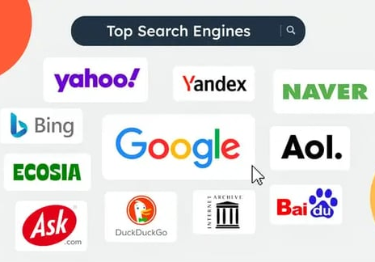
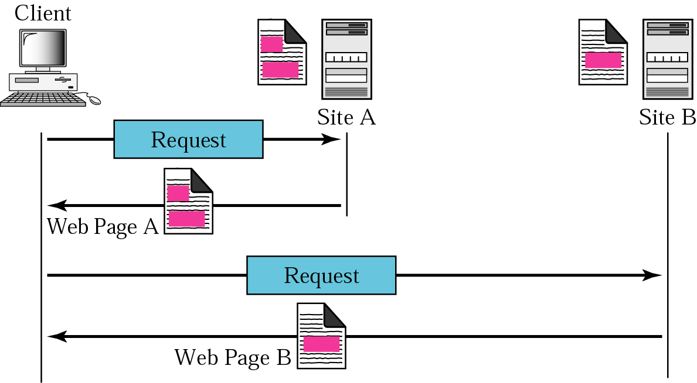
World Wide Web
search engine is a software system that helps you find information on the internet. It acts like a giant index that keeps track of billions of web pages and their content.

Slide 26
World Wide Web
The documents in the WWW can be grouped into
Statice Documents :- a document with a fixed content
Dynamic Documents (server side):-
content of the document is created when the browser accesses the server.
When the browser request arrives, the server runs an application that creates dynamic documents.
Active Documents (client side):-
provide a continuous update of the screen content

Slide 27
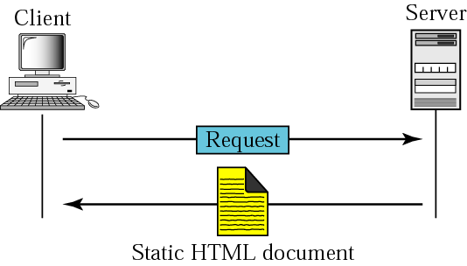
World Wide Web
Static document

Slide 28
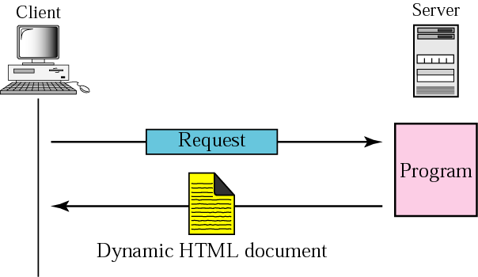
World Wide Web
Dynamic document using CGI

Slide 29
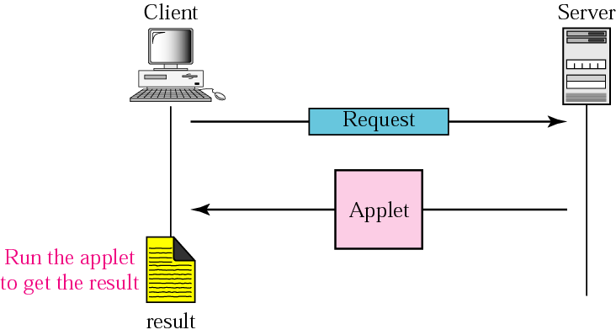
World Wide Web
Active document using Java applet
Notes:
Applet is a special type of program that is embedded in the webpage to generate the dynamic content. It runs inside the browser and works at client side.

Slide 30
World Wide Web
Web applications
Very wide range of functionality
web mail
online retail sales and auction sites
wikis, discussion boards, weblogs
online news, radio, tv, etc….
multi-player online role-playing games, etc…
software components of a web app
web server
configuration files
general processor components
e.g. PHP, ASP processors

Slide 31
World Wide Web
software components of a web app
Databases
possibly distributed or mirrored
Session information
statefull servers hold session information
may persevere in a database
Global Information
shared by all or many web app processes
e.g. number of hits on the site, user profiles

Slide 32
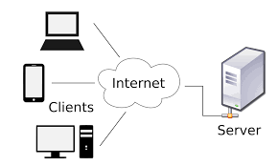
Client-Server Architecture
A network architecture in which each computer or process on the network is either a client or a server
Components of client/server architecture:
Communication network
Clients
Servers

Slide 33
HTTP
Hypertext Transfer Protocol (HTTP):
application-level protocol for distributed, collaborative, hypermedia information systems
It is generic
can be used for many tasks, such as name servers & distributed object management systems
Notes:
HTTP is a generic and stateless protocol which can be used for other purposes as well using extensions of its request methods, error codes, and headers.
Basically, HTTP is a TCP/IP based communication protocol, that is used to deliver data (HTML files, image files, query results, etc.) on the World Wide Web.

Slide 34
HTTP
HTTP/1.0 allowed only connectionless message passing
each request/response required a new connection
to download a page there is overload the server, lots of overhead
HTTP/1.1 provides persistent connection by default
once client & server connect, remains open until told to close it (or timeout)‏
reduces number of connections, saves overhead
client can send multiple requests without waiting for responses
e.g., can request all images in a page at once

Slide 35
HTTP
Request-Response:
Request: The client sends an HTTP request to the server. This request includes:
Method: The type of action being requested (e.g., GET to retrieve a webpage, POST to submit a form).
URL: The address of the specific resource being requested.
Headers: Additional information about the request, like the browser type or cookies.
Body (Optional): Data sent along with the request, often used for form submissions.
Response: The server processes the request and sends back an HTTP response. The response includes:
Status Code: A three-digit code indicating the outcome of the request (e.g., 200 OK, 404 Not Found).
Headers: Additional information about the response, like the content type or server information.
Body: The actual data being sent, like the HTML content of a webpage or the result of a form submission.

Slide 36
Example of an HTTP Request from a Web browser
Command URL HTTP version
GET http://www.kelley.indiana.edu/ardennis/home.htm HTTP/1.1
Date: Mon 06 Aug 2001 17:35:46 GMT
User-Agent: Mozilla/6.0
Referer: http://www.indiana.edu/~aisdept/faculty.htm
]- Request
Line
]- Web browser (this is Netscape)
Request Header
URL that contained the link to the requested URL

Slide 37
HTTP Request Types
GET
Appends form data directly to the end of the URL—visible to users (not suitable for sending passwords)
Limited to 1024 characters for the entire URL
Result page can be bookmarked and cached
POST
Sends form data in the HTTP request—invisible to users
Virtually no limit (but check your specific configuration)
Results are not cacheable or bookmarkable

Slide 38
HTTP response from a Web server
HTTP/1.1 200 OK ]- Response Status
Date: Mon 06 Aug 2001 17:35:46 GMT ]- Date
Server: NCSA/1.3 ]- Web server
Location: http:// www.kelley.indiana.edu/adennis/home.htm ]- URL
Content-type: text/html ]- Type of file
<html>
<head>
<title>Allen R. Dennis</title>
</head>
<body>
<H2> well came to internet programming </H2>
<P>Welcome to the home page of Allen R. Dennis</P>
</body>
</html>
Response Header
Response
Body

Slide 39
HTTP Response header fields
The first line of the server’s response contains a status code 200 OK
200 OK | request was processed successfully
301 Moved permanently | document has been moved
304 Not modified | if cached version is up-to-date
400 Bad request | syntax error in client’s request
Forbidden | client is not allowed access e.g., protected
404 Not found | file could not be found
500 Internal server error | server failed
503 Service unavailable | server is overloaded
Notes:
500 internal server error-server failed
The web server receives the request and attempts to process it.
However, during the processing of the request, an unexpected error occurs. This error could be due to various reasons such as a misconfiguration, programming error, insufficient server resources, database connection issues, or a bug in the server-side code.

Slide 40
HTTP Response header fields
In addition to the status code, the server’s response may include
Date,
Server info,
Last-modified,
Content-length,
Content-type , Expires

Slide 41
https (Hyper Text Transfer Protocol Secure)
is a secure version of the Hyper (http).
HTTPS allows secure ecommerce transactions, such as online banking.
Web browsers such as Internet Explorer and Firefox display a padlock icon to indicate that the website is secure, as it also displays https:// in the address bar.
When a user connects to a website via HTTPS, the website encrypts the session with a digital certificate.
“you never and ever enter your credit card number and sensitive information in an http website!”

Slide 42
Static vs. dynamic pages
Static Web Pages
most Web pages are static
Contents (text/links/images) are the same each time it is accessed
e.g., online documents, most homepages
HTML is used to specify text/image format
Dynamic Web Pages
as the Web moves towards online services and e-commerce, Web pages must also provide dynamic content
pages must be fluid, changeable (e.g., rotating banners)‏
must be able to react to the user's actions, request and process info, tailor services
e.g., amazon.com, www.yahoo.com

Slide 43
Client-Side Scripting versus Server-Side Scripting
Client-side scripts
Validate Reduce requests needed to be passed to server
Access browser
Eg. Java script, vb script etc
Server-side scripts
Executed on server
Generate custom response for clients
Wide range of programmatic capabilities
Access to server-side software that extends server functionality
Eg ASP, PHP, JSP

Slide 44
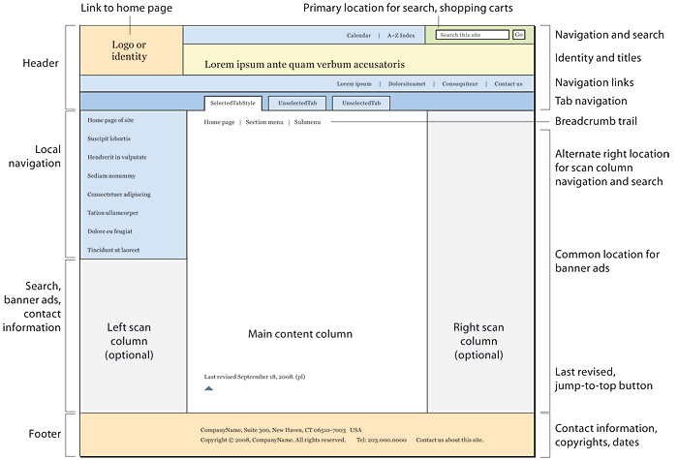
Designing Web Applications
Page Structure and Site Design

Slide 45

Web design-it is to make web sites pleasing and good look by designing and adding features like colors, Combination of lines, shapes, texture and others. (A) To design web sites: - we need to gather information, in such a way that:- 1. Purpose of the web site/application. 2. Goals of web site. Is it to entertain or what? 3. from where the information comes from?
Designing Web Applications

Slide 46
Designing Web Applications
(B) Organize the information:-
1. Alphabetical order
2. Chronological order- associated with date.
3. Geographical
4. Topical- by using topics.
5. Task-according to their purposes example download, read reviews.
6. Priority- according to their importance, and priority.

Slide 47
Designing Web Applications
(C) Structure
1. Hierarchical:-takes a top down approach (from high level categories to logical sub categories) and helps to visualize the structure of the web site.
2. Hypertext structure-text or an image linked to another page.
3. Database structure-used for easily to maintain and updated outside of the web site itself.

Slide 48
Designing Web Applications
(D) Develop a navigation schema:-user moves around the site and finds the information.
These include…..
Forward and backward arrows.
Bookmarks or favorites lists
Standard display for visited/unvisited lists
Status bar
Page URLs

Slide 49
(E) Layout the web pages:-it is the way pages are arranged.
A few things should be remember to lay out a web site….
Use industry standard HTML tags and test in different browsers, browser versions.
Monitor resolution- can also affect the width and the height of the page so fix the computer resolution before.
Data transfer-file size:-try not to put unnecessary images because it will slow down the data transfer progress.
Consistent banner image-should be the same in page to page.
Page back ground-solid color is the best to
Use HTML Tables for controlling the layout of the web pages.

Slide 50
(F) Web accessibility:-should be accessible to all
Some tips to make the site accessible for all are as follows:-
1. Hypertext links should be descriptive.
2. Provide alternative text descriptions for all graphics.
(G) Test the site:- for functionality (check for forms, tables, images and others) and for usability (checking not cleared things for the users).

Slide 51
Designing Web Applications
It is challenging because it needs many languages to learn!
Client side design
visual and logical layout
Validation
JavaScript controls and content manipulation
Server side:
Database design
Server-side language and design patterns
Security
Performance and Reliability (24/7)‏

Slide 52

THANK YOU

